Slide 1
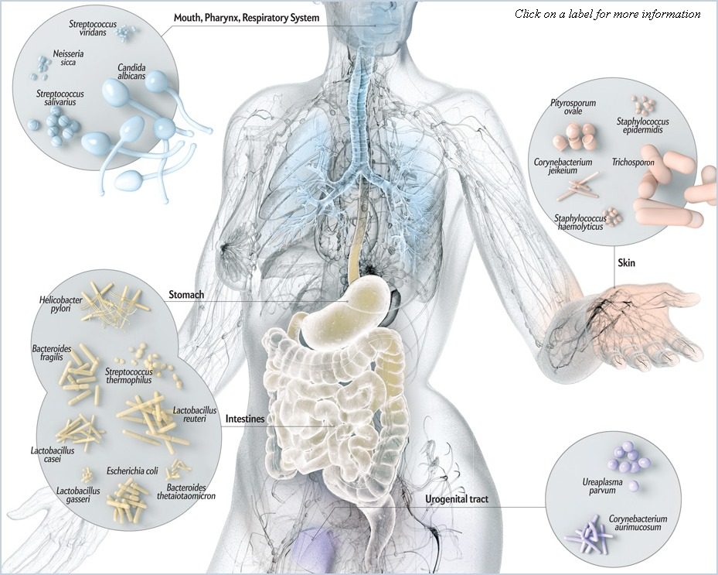
Analyzing the Microbiome
Notes:
Lead a discussion about the microbiome/microbiota and why it’s so important to study
How might the microbiom affect health?
Where do the microbes come from?
What could affect the microbiome of an organism?

Slide 2
Review from last week – dada2 workflow
Input
.fastq files of DNA sequences and quality info
Trim and Filter
Trim sequence ends and filter based on quality
Learn error
Build error models (help distinguish real unique sequences from sequences that differ due to sequence errors)
Dereplicate, Infer ASVs
Identify unique sequences and count them
Merge forward and reverse reads
Chimera Removal
Identify and remove chimeric sequences
Merge
Assign taxonomy
Match sequences with taxonomic information
Tree
Construct phylogenetic tree
Phyloseq Handoff
Combine sequence table, taxonomy info, sample info, and tree into phyloseq object

Slide 3
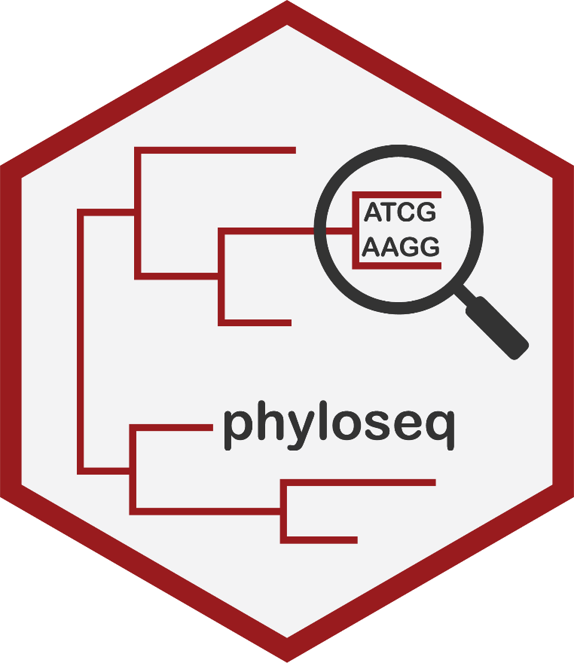
Phyloseq
“The phyloseq package is a tool to import, store, analyze, and graphically display complex phylogenetic sequencing data that has already been clustered into OTUs[/ASVs], especially when there is associated sample data, phylogenetic tree, and/or taxonomic assignment”
Combines existing R tools for ecology and phylogenetic analysis as well as graphics creation (ggplot2)
https://joey711.github.io/phyloseq/

Slide 4
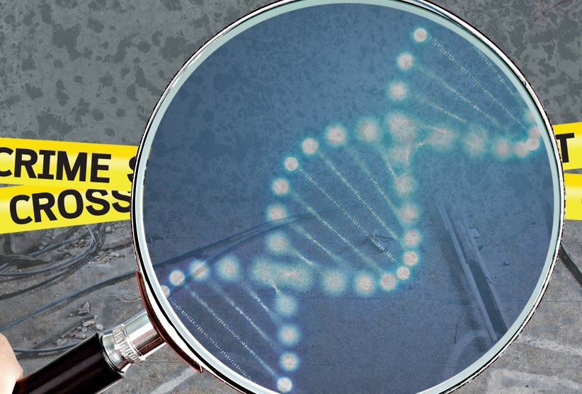
Describing the microbiome: Who’s there?

Slide 5
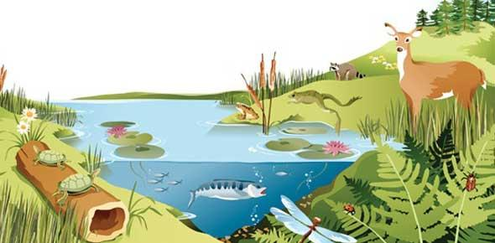
Describing the microbiome: Alpha diversity
“a dynamic and interactive micro-ecosystem”
Alpha diversity reflects richness and evenness of a community
Richness: Number of different taxa in a community
Evenness: Distribution of organisms in different taxa in a community

Slide 6
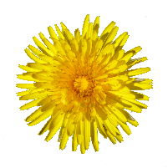

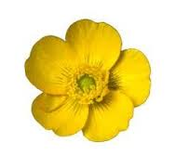
Describing the microbiome: Alpha diversity
Community 1
Community 2
Community 3
Richness is just observed # of taxa.
Various indices (Shannon, inverse Simpson, etc.) calculate an alpha diversity score accounting for both richness and evenness.

Slide 7
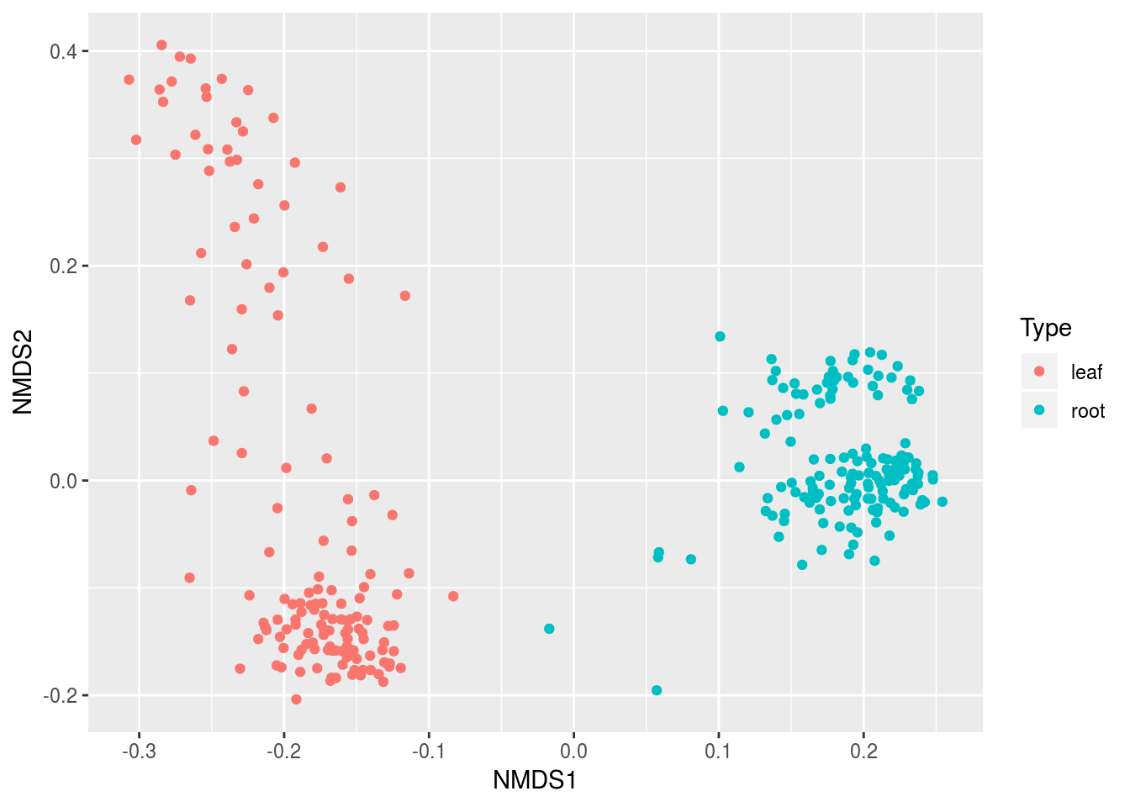
Describing the microbiome: Beta diversity
Beta diversity reflects the degree of dissimilarity among communities
Can reveal major differences in overall community composition based on variables of interest
Step 1 – different metrics (Bray-Curtis, Jaccard, UniFrac, etc) can be used to quantify dissimilarity pairwise between all samples
Step 2 – produce ordination based on distance or dissimilarity matrix to represent dissimilarity in a low-dimensional space

Slide 8
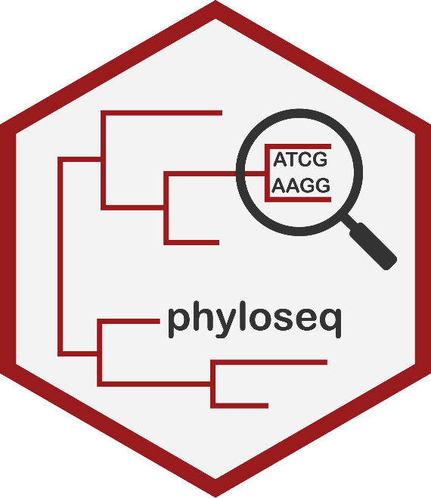
Phyloseq lesson
Importing data into phyloseq
Phyloseq data wrangling
Visualizing abundance data
Alpha diversity
Beta diversity
Let’s look at some data

